Slide 1
Revision

Slide 2
General Expectations Onwards
2 hours’ work a night (Some of you will need to do more; others need to do less!)
Rest and socialising are important
Independent study is vital

Slide 3
Why?
Being successful now reduces exam stress in the future
It is better for your mental health
We care deeply about how you do
Grades change lives

Slide 4
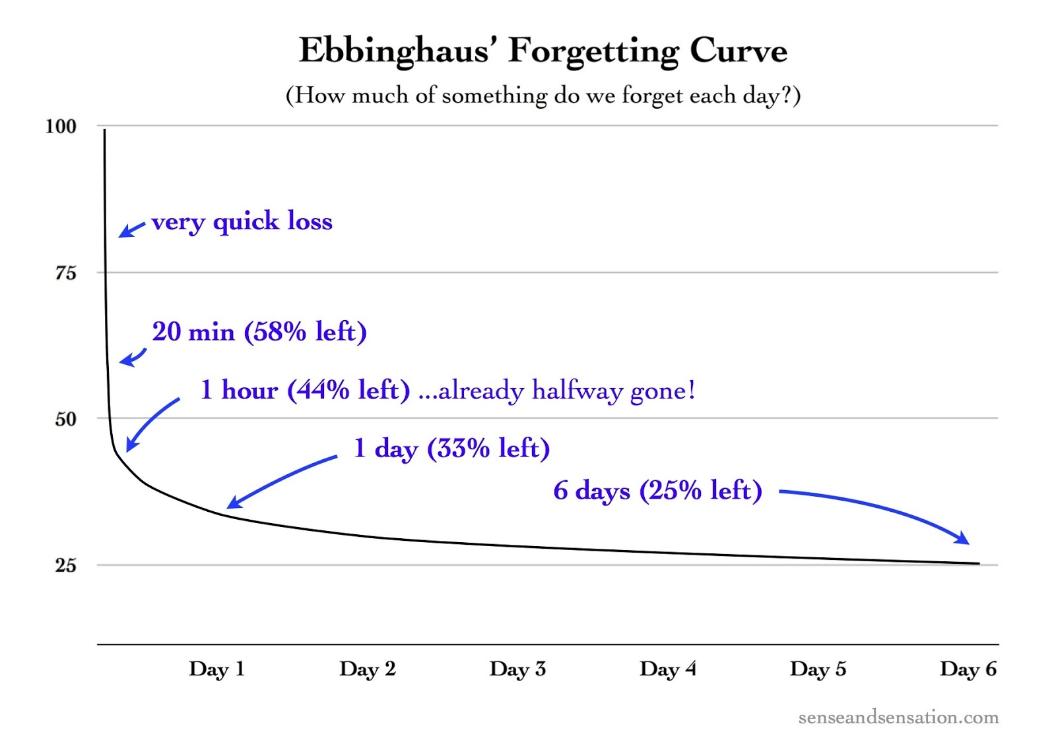
Forgetting: WITHOUT REVISION…

Slide 5
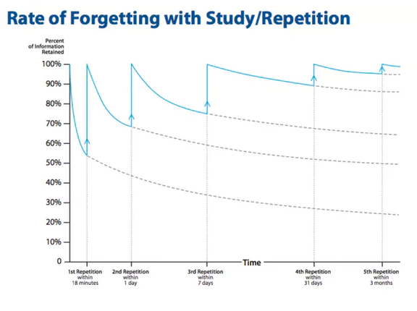
Forgetting: WITH REVISION…

Slide 6
Revision
What to do & what not to do…

Slide 7
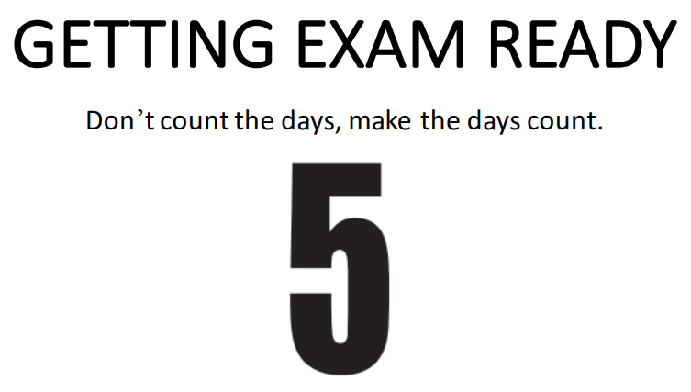
Whatever your starting point, you have time to make a difference to your grades.

Slide 8
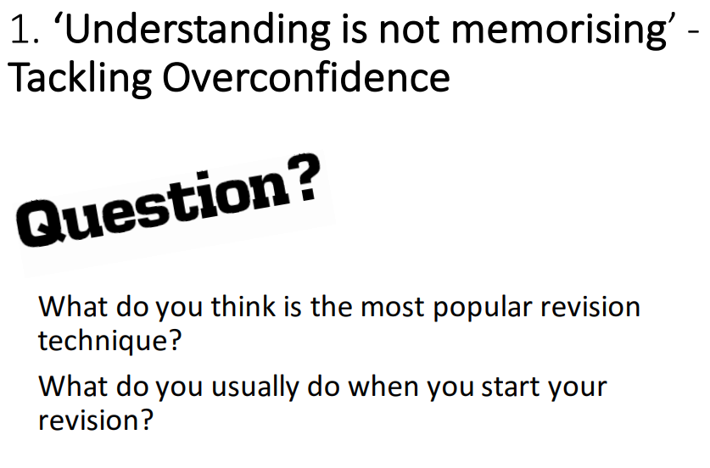

Slide 9
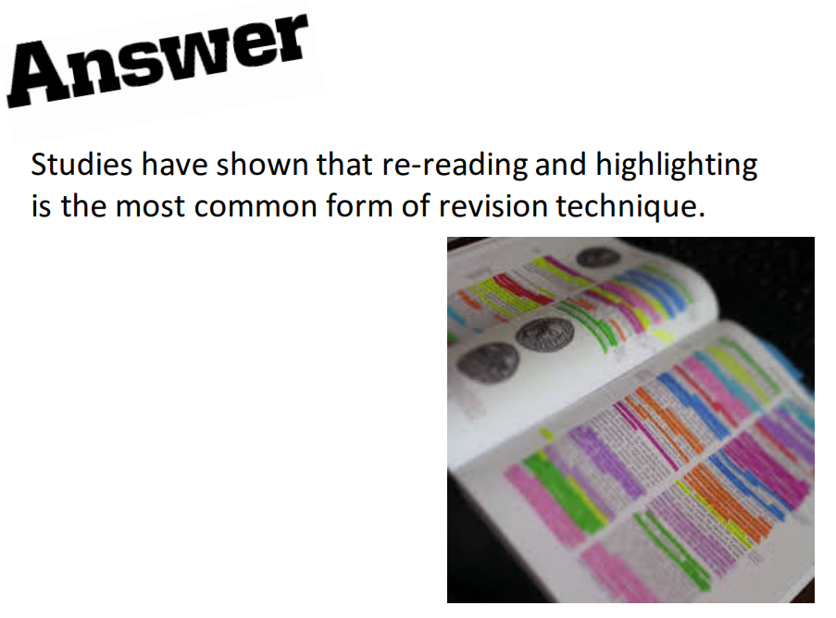

Slide 10
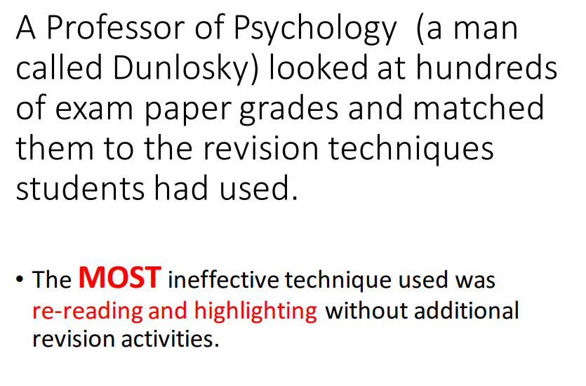

Slide 11
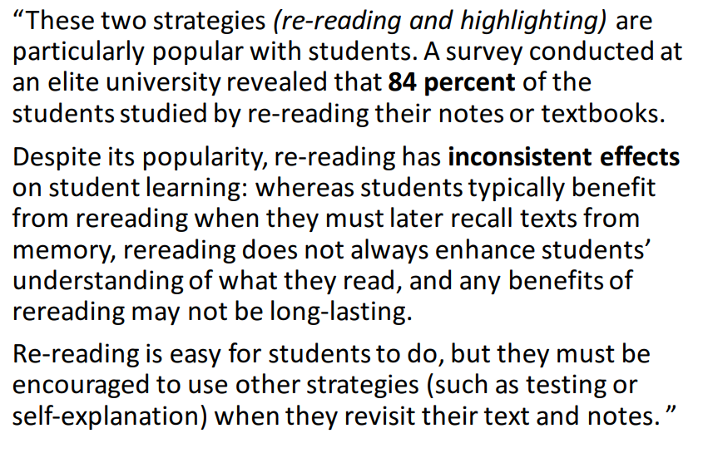
Dunlosky said…

Slide 12
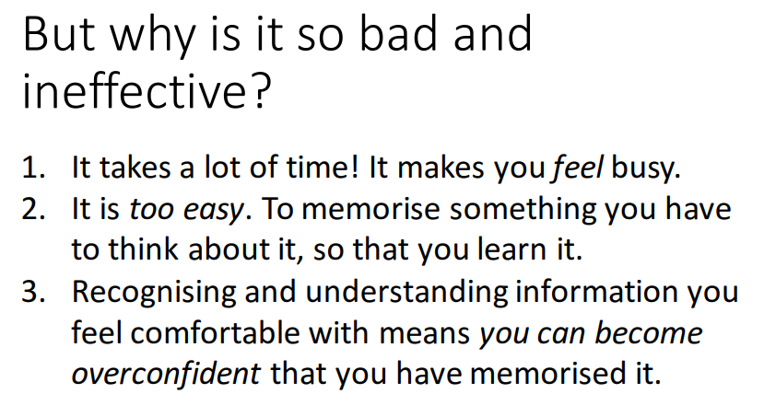

Slide 13
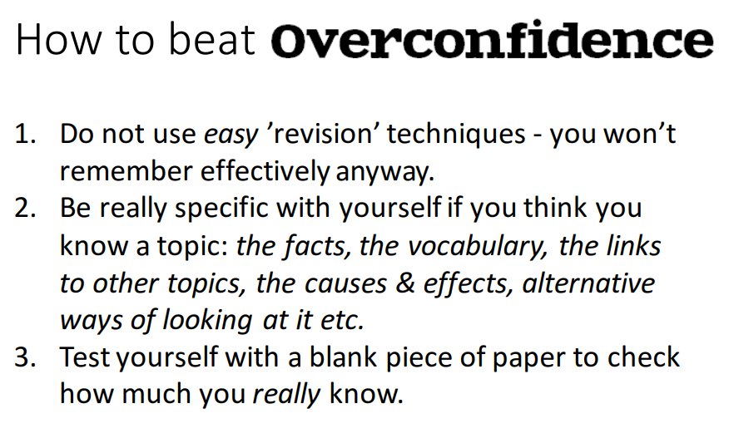

Slide 14
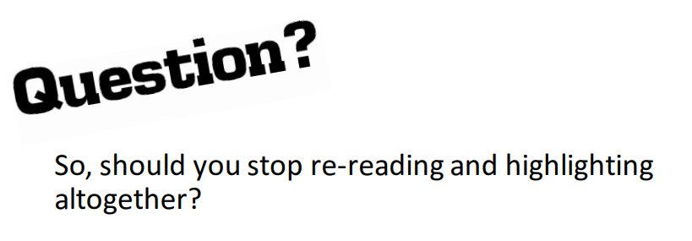
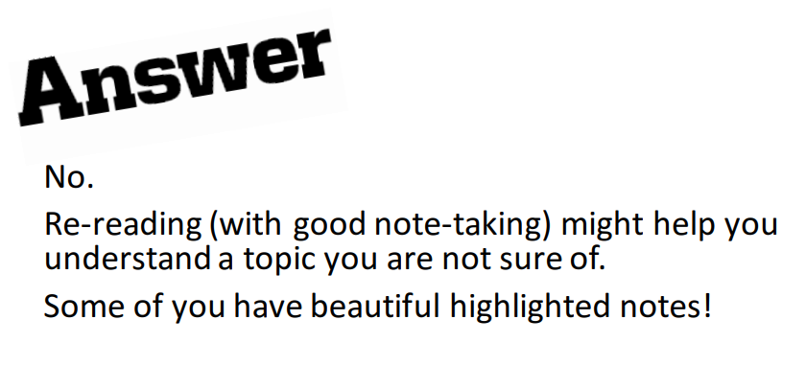
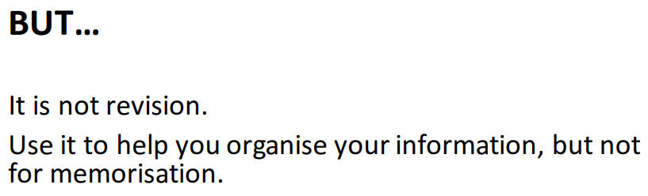

Slide 15

What should I be doing instead?
Over the coming weeks, we will look at specific strategies that help you engage with learning in a more active way that does actually help you learn things. These are:
Using Seneca
Cornell Notes
Retrieval Practice
Spacing
Elaboration/Self Explanation
Dual Coding
Interleaving
Leitner Method (Help with organising your revision)
Pomodoro Method (Help with organising your revision)
We’re going to explore these over the next few weeks so that you have a range of strategies to choose from.
Let’s find what works for you!

