Slide 2
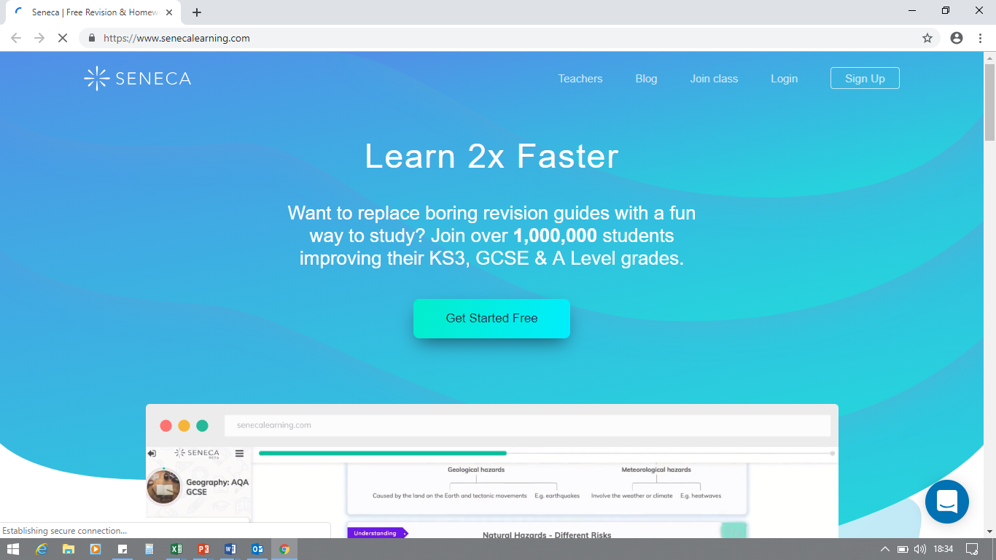
Revision
Using

Slide 3
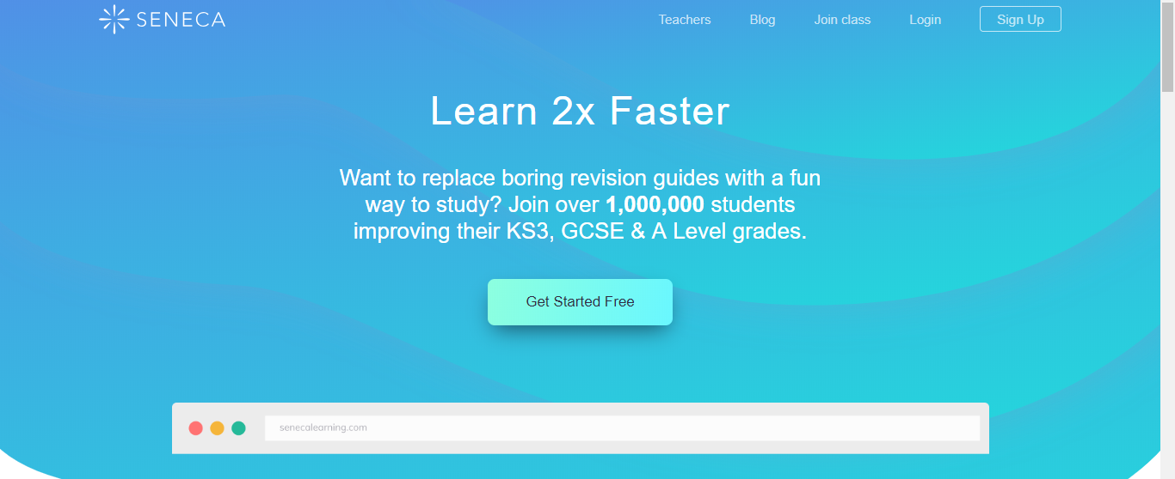


Slide 4
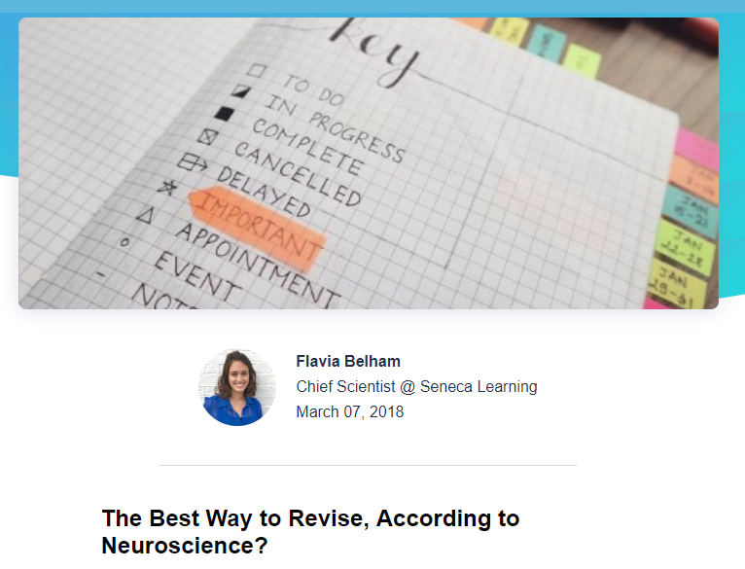
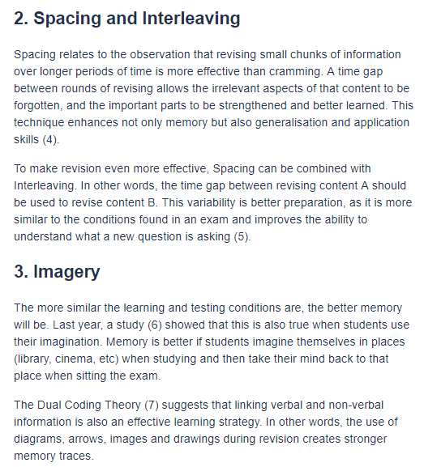
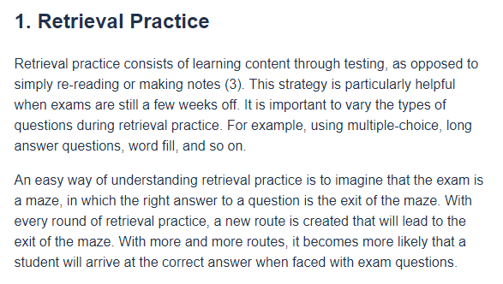

Slide 5
Available for…
Not yet available for…
Business Studies
Combined Science (Trilogy) Biology
Combined Science (Trilogy) Chemistry
Combined Science (Trilogy) Physics
Computer Science
Food & Preparation
English Language
English Literature
Geography
History
Maths
Media Studies
French
Spanish
PE
Religious Studies
Biology
Chemistry
Physics
Science Practicals
Art & Design
BTEC Animal Care
National Certificate in Child Development
Citizenship Studies
Design & Technology
National Certificate in Engineering
Drama
National Certificate in Health & Social Care
CiDA
Music
National Certificate Sports Science
Exam Board Specific Content!

Slide 6


Slide 7
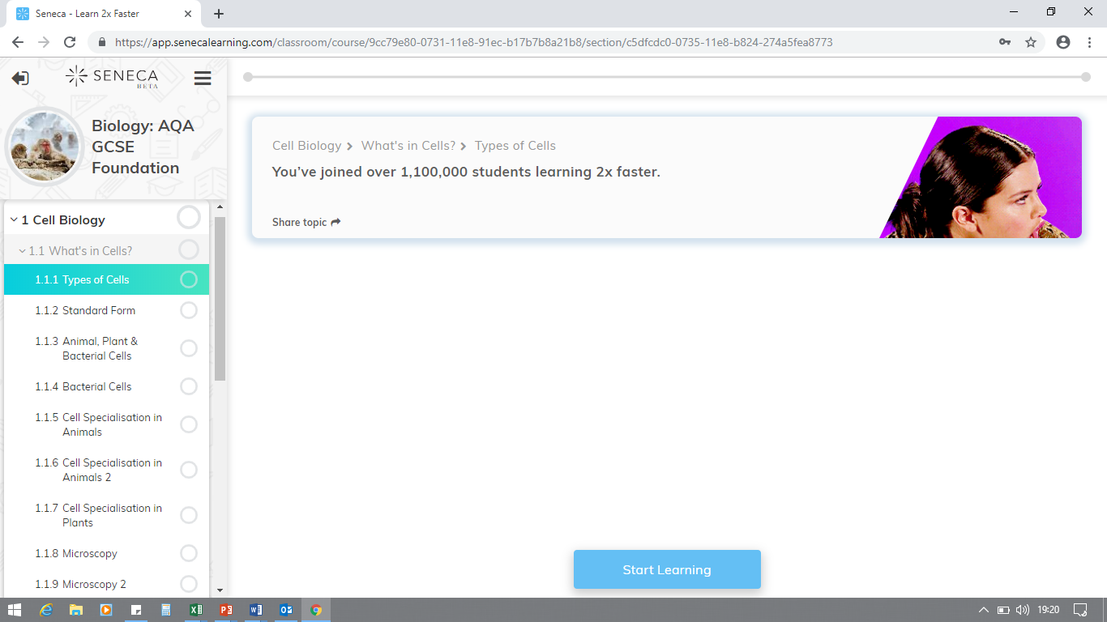

Slide 8
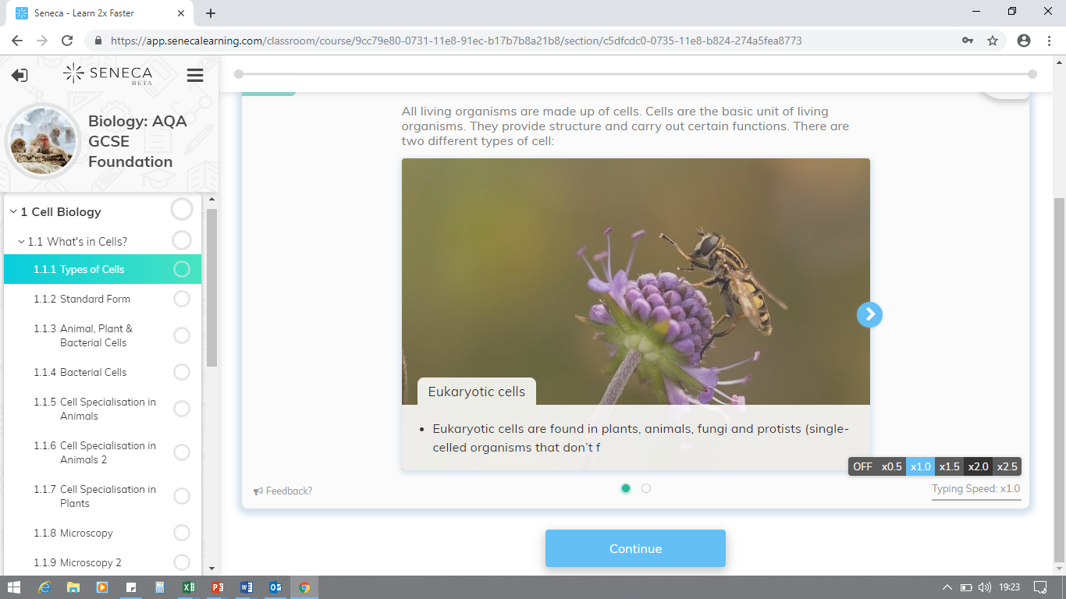

Slide 9
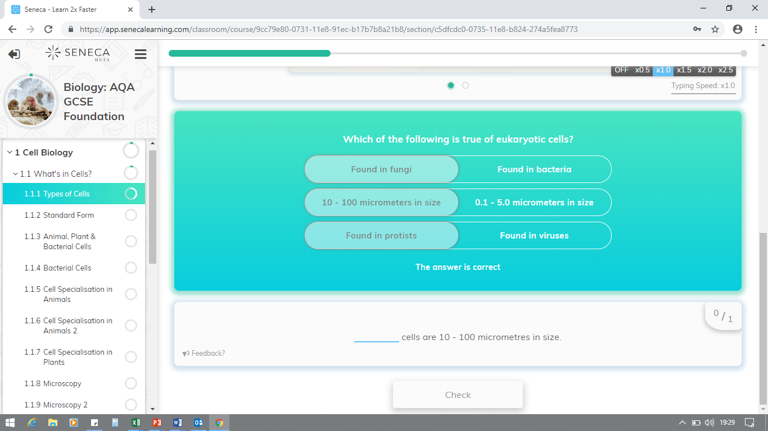

Slide 10
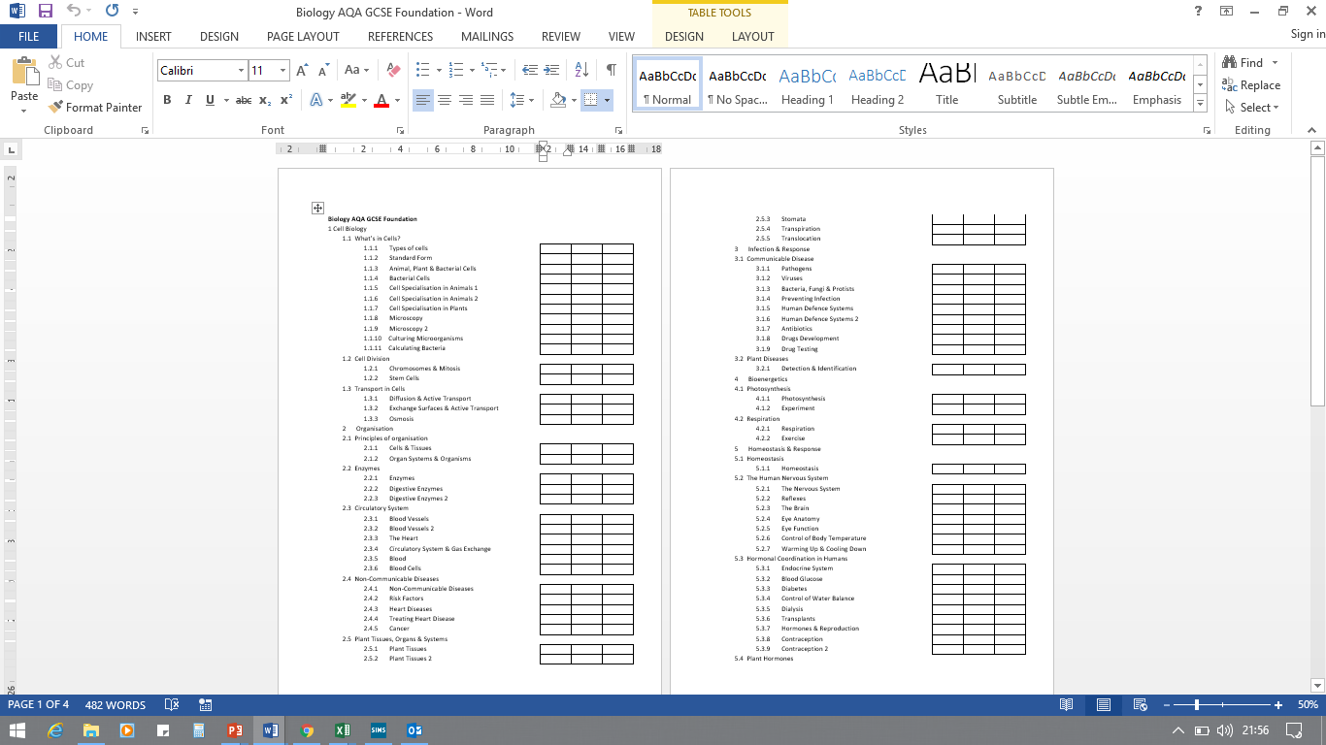
Booklet of Subject Checklists:

