Slide 1
Cornell Notes
A specific strategy to help your long term learning.

Slide 2
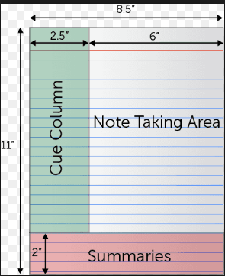
Cornell Notes Method

Slide 3

https://www.youtube.com/watch?v=ErSjc1PEGKE

Slide 4
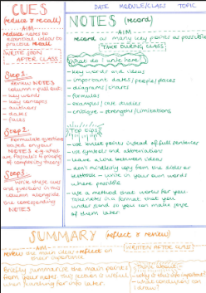
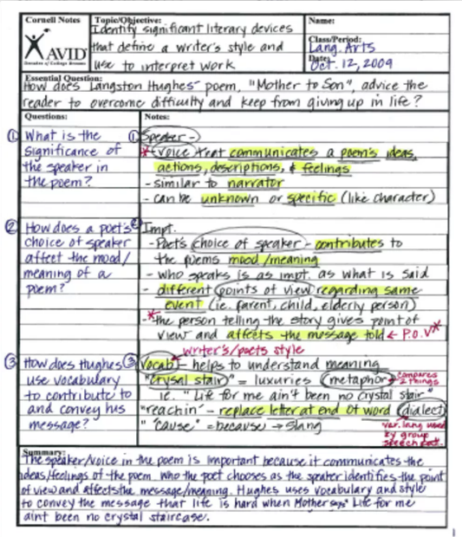
Cornell notes – how?

Slide 5
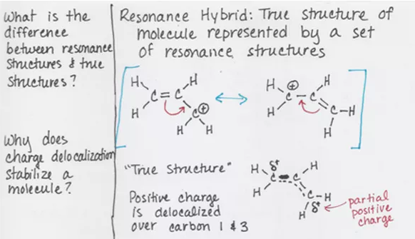

Cornell Notes – making them useful
Your questions need to be clear – remember you’ll come back to these out of context. Do you know what you’re on about?!
The notes section needs to be detailed enough to cover everything you need to know. Remember you’re using it in the future when you’ve actually forgotten it. Write it for your future self.

Slide 6
Why?
“It is useful for re testing – you just go back to the questions on the side in a few days and check if you remember the answer. If not, you can remind yourself easily with the bit on the right.”
“It helps you to learn the subject in detail as you are reflecting on the key points.”
“Summarising the content really helps you learn it. You’re doing something active with it which has more impact on your long term learning.”

Slide 7
What should I be doing?
Using your notes/knowledge organiser/revision guide, read through one topic.
Using the resource above, produce your notes on the right.
Once you have produced your notes, move on to the questions. Pick things that have clear answers in your notes.
Once you have done this, move on to the summary at the bottom. In your own words, summarise the topic.
Once or twice a week, check back and try to answer the questions on the left. If you have forgotten, that is fine. The brain forgets things. Re read through the notes and the summary then answer the question again.

