Slide 1
Forgetting…the enemy of revision?
Ebbinhaus and Spacing

Slide 2

Ebbinghaus
https://www.youtube.com/watch?v=SCsQHe-NpaM
A German Psychologist
A key player in understanding how we learn and forget things

Slide 3
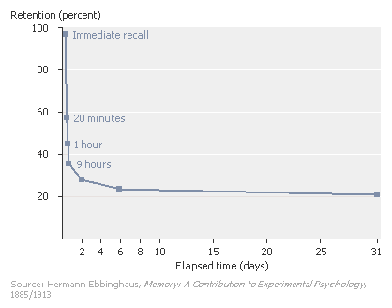
The curve

Slide 4
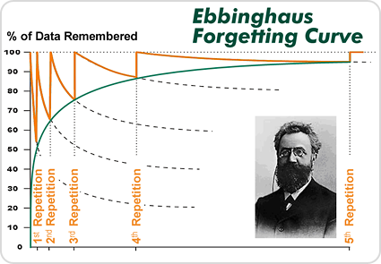
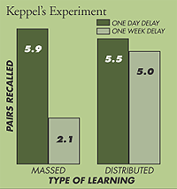
Working to over come it
The more repetition (practice), the more likely information is to be remembered later.

Slide 5
Spacing
The Learning Scientists
https://www.youtube.com/watch?v=3WJYp98eys8

