Slide 1
Pomodoro technique
A way to keep yourself working effectively

Slide 2

Pomodoro technique
A well used strategy for productivity
Widely used in the work place
Also widely used in schools/universities as a strategy for effective study time

Slide 3

What is it?
https://www.youtube.com/watch?v=mNBmG24djoY

Slide 4
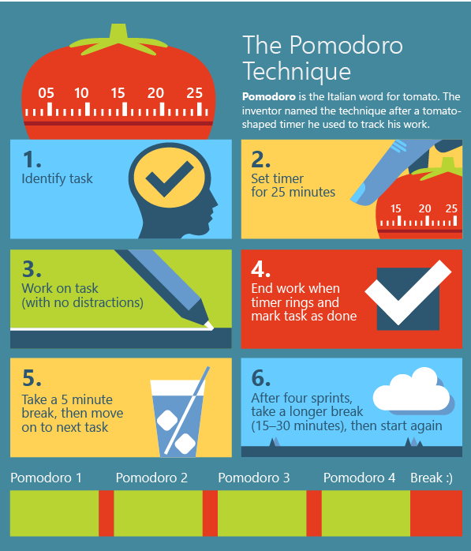
How do I do it?

Slide 5
How can I apply this to my revision?
Spend 10 minutes making a list of:
What you need to re visit that you have revised recently.
What you need to focus on revising from scratch.
Split these into chunks e.g English, History – revisit these. Maths – alegbr – revise this!
Use your 25 minutes to do things like:
Create Cornell Notes on one of the subjects
Review previous revision using your flashcards
Review previous revision using your Cornell Notes by reading your questions on the left and checking your understanding.
Do some Self Explanation/Feynman Method.

